Slide 1
Simple Calculator

Slide 2
Basic Idea
Front-End

Slide 3
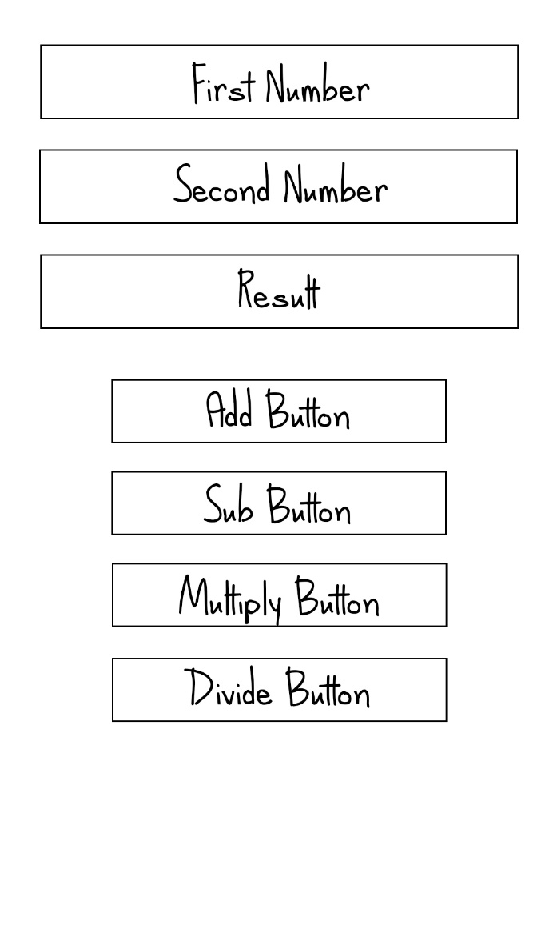
Rough Sketch

Slide 4
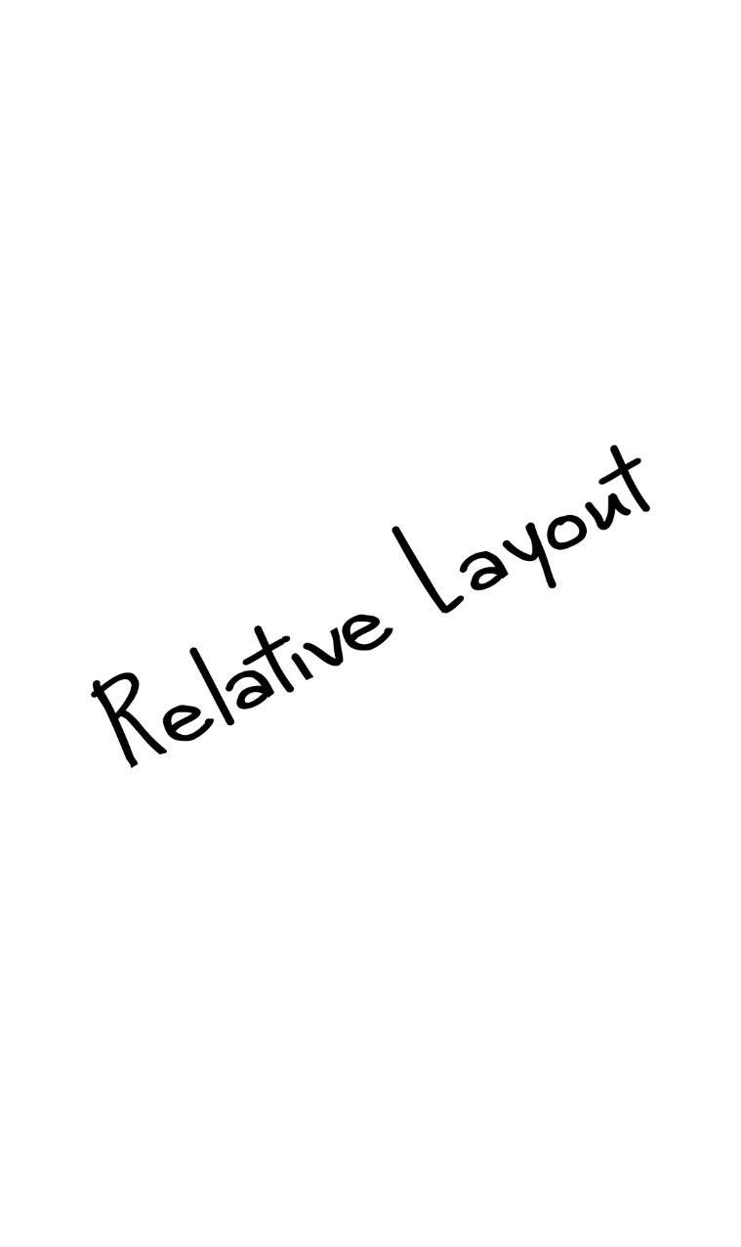
Layout
Choose Relative Layout

Slide 5

EditText
Id= firstNumber
layout_width="wrap_content“
layout_height="40dp“
layout_alignParentTop="true“
layout_marginTop="50dp"
layout_marginStart="20dp“
layout_marginEnd="20dp“
paddingStart="10dp“
paddingEnd="10dp"

Slide 6
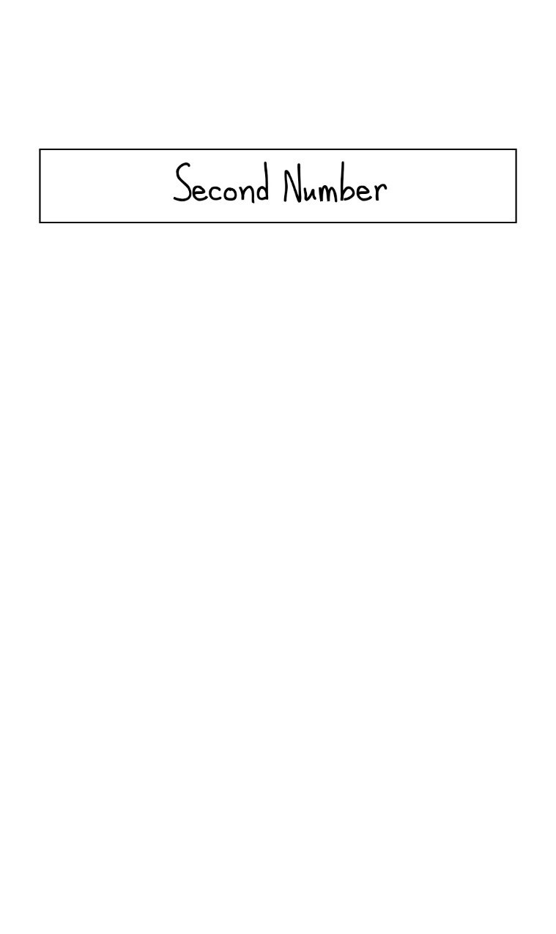
EditText
Id= secondNumber
layout_width="wrap_content“
layout_height="40dp“
layout_alignParentTop="true“
layout_marginTop="110dp"
layout_marginStart="20dp“
layout_marginEnd="20dp“
paddingStart="10dp“
paddingEnd="10dp"

Slide 7

TextView
Id= resultText
layout_width="wrap_content“
layout_height="40dp“
layout_alignParentTop="true“
layout_marginTop="170dp"
layout_marginStart="20dp“
layout_marginEnd="20dp“
paddingStart="10dp“
paddingEnd="10dp"

Slide 8
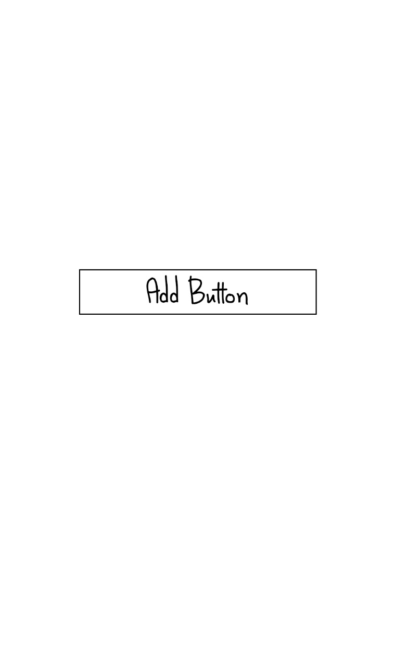
Button
Id= addButton
layout_width="wrap_content“
layout_height="40dp“
layout_alignParentTop="true“
layout_marginTop="260dp"
layout_marginStart="100dp “
layout_marginEnd="100dp “

Slide 9
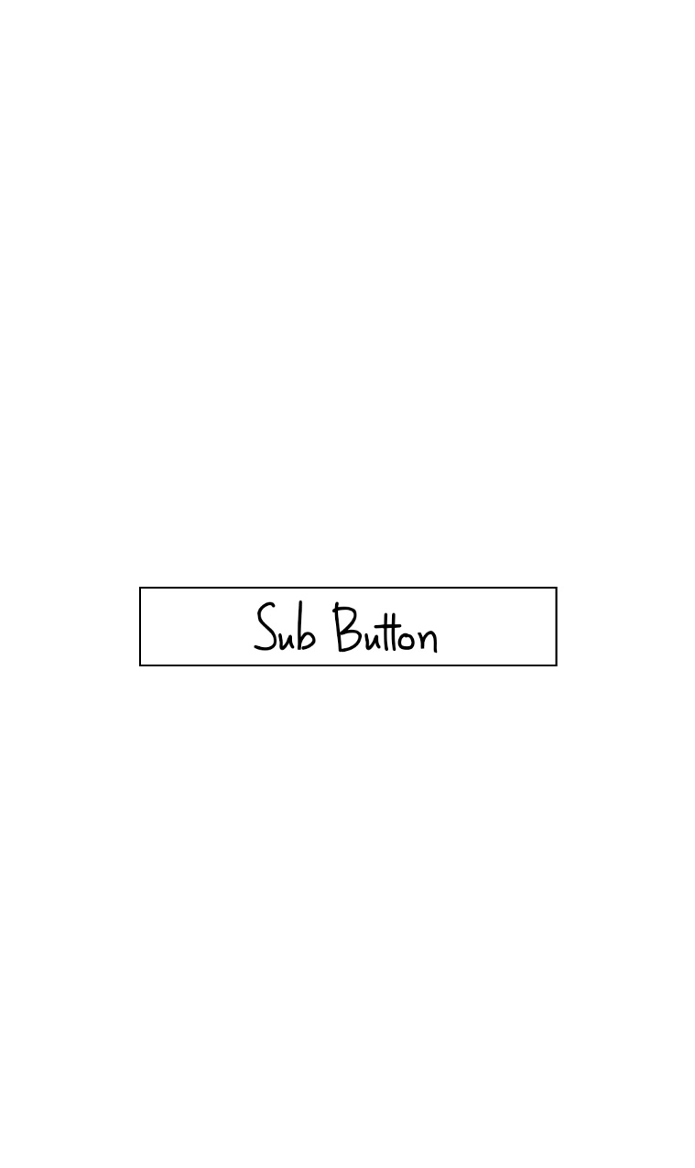
Button
Id= subButton
layout_width="wrap_content“
layout_height="40dp“
layout_alignParentTop="true“
layout_marginTop="340dp"
layout_marginStart="100dp “
layout_marginEnd="100dp “

Slide 10

Button
Id= mulButton
layout_width="wrap_content“
layout_height="40dp“
layout_alignParentTop="true“
layout_marginTop="420dp"
layout_marginStart="100dp “
layout_marginEnd="100dp “

Slide 11

Button
Id= divButton
layout_width="wrap_content“
layout_height="40dp“
layout_alignParentTop="true“
layout_marginTop="500dp"
layout_marginStart="100dp “
layout_marginEnd="100dp “

Slide 12
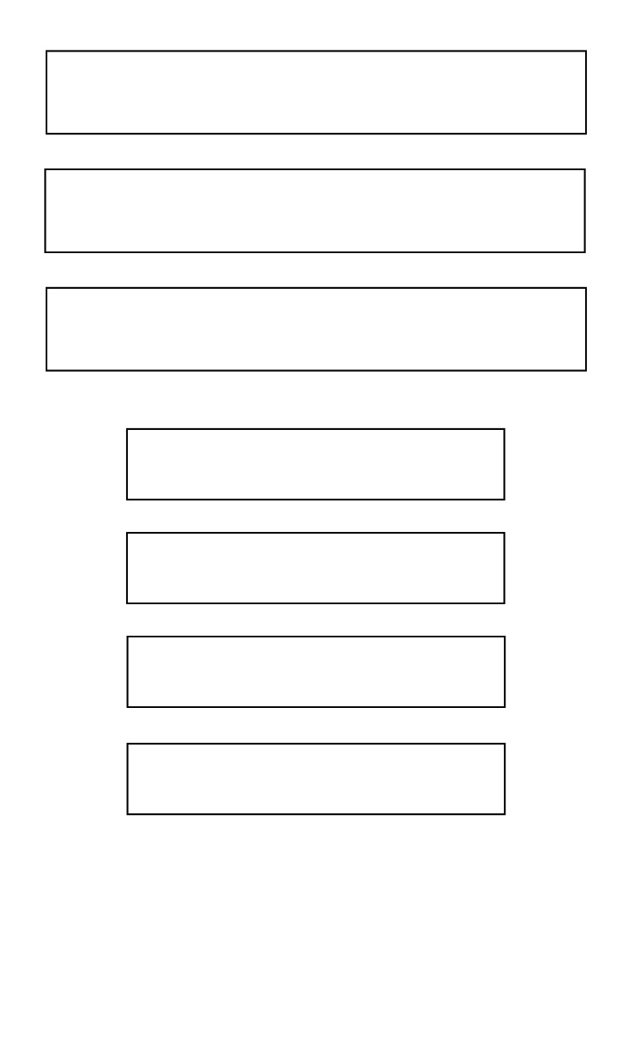
Layout Model
What Next???

Slide 13
Concentrate on Values

Slide 14
Declare Colors
<color name="colorPrimary">#7df9ff</color>
<color name="colorPrimaryDark">#7df9ff</color>
<color name="colorAccent">#D81B60</color>
<color name="colorLightBlue">#7df9ff</color>
<color name="white">#ffffff</color>
<color name="black">#000000</color>

Slide 15
Declare Strings
<string name="app_name">My Application</string>
<string name="calc">Calculator</string>
<string name="firstNum">Enter the first Number</string>
<string name="secondNum">Enter the second Number</string>
<string name="result">Result</string>
<string name="add">ADD</string>
<string name="sub">SUB</string>
<string name="mul">MULTIPLE</string>
<string name="div">DIVIDE</string>
<string name="result_value">%.2f</string>

Slide 16
Improving Front End

Slide 17
Designing Shapes

Slide 18

Button
<shape xmlns:android="http://schemas.android.com/apk/res/android" android:shape="rectangle">
<solid android:color="#0100ff"/>
<corners android:bottomLeftRadius="10dp"
android:topLeftRadius="10dp"
android:bottomRightRadius="10dp"
android:topRightRadius="10dp" />
</shape>

Slide 19

Rectangle
<shape xmlns:android="http://schemas.android.com/apk/res/android"
android:shape="rectangle">
<corners android:bottomLeftRadius="15dp"
android:topLeftRadius="15dp"
android:bottomRightRadius="15dp"
android:topRightRadius="15dp" />
<stroke android:width="2px"
android:color="#000000" />
<gradient android:angle="45"
android:startColor="@color/white"
android:endColor="#ff00ff"/>
</shape>

Slide 20

Result_box
<shape xmlns:android="http://schemas.android.com/apk/res/android"
android:shape="rectangle">
<corners android:bottomLeftRadius="15dp"
android:topLeftRadius="15dp"
android:bottomRightRadius="15dp"
android:topRightRadius="15dp" />
<solid android:color="#ffffff" />
</shape>

Slide 21

Change Bg Colour
<RelativeLayout
android:background="@color/colorLightBlue“ >

Slide 22
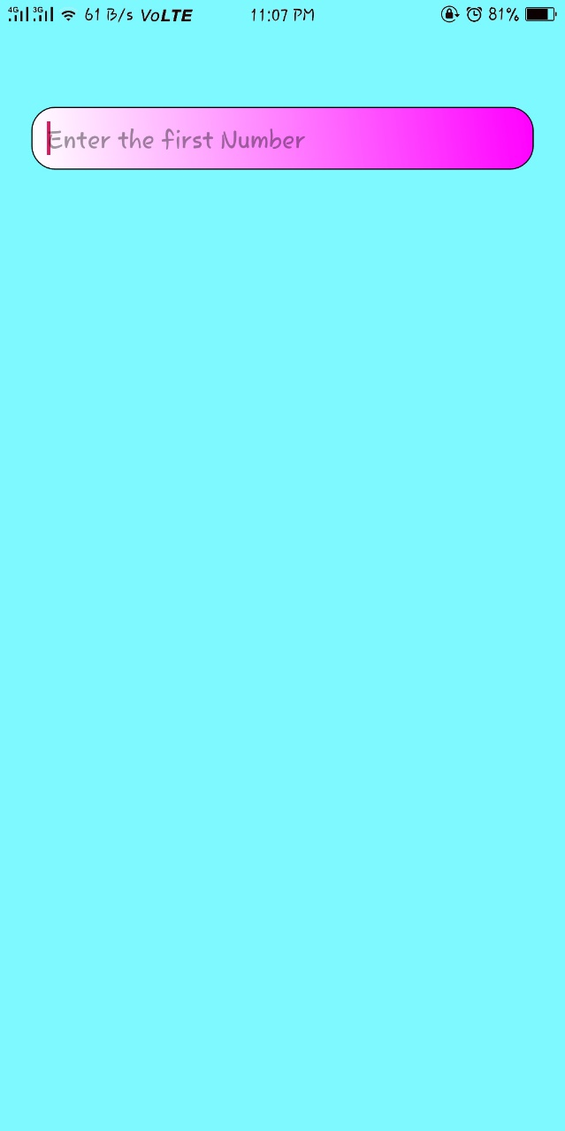
Change First NUmber
<EditText
android:id="@+id/firstNumber"
android:background="@drawable/rectangle"
android:hint="@string/firstNum"
tools:ignore="Autofill"
android:inputType="numberSigned" />

Slide 23
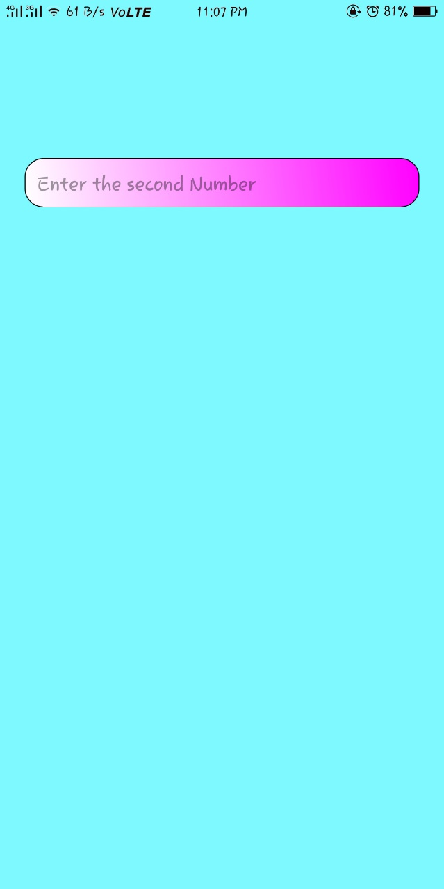
Change Second NUmber
<EditText
android:id="@+id/secondNumber"
android:background="@drawable/rectangle"
android:hint="@string/secondNum"
tools:ignore="Autofill"
android:inputType="numberSigned" />

Slide 24

Change Result
<TextView
android:id="@+id/resultText"
android:background="@drawable/result_box"
android:text="@string/result"
android:gravity="center_horizontal|center_vertical"
android:textColor="@color/black"
android:textSize="24sp" />

Slide 25
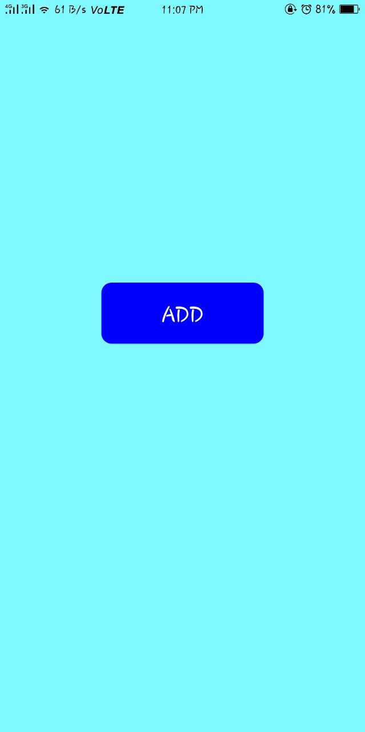
Change ADD BUTTON
<Button
android:id="@+id/addButton"
android:background="@drawable/button"
android:text="@string/add"
android:textColor="@color/white"
android:textSize="24sp" />

Slide 26
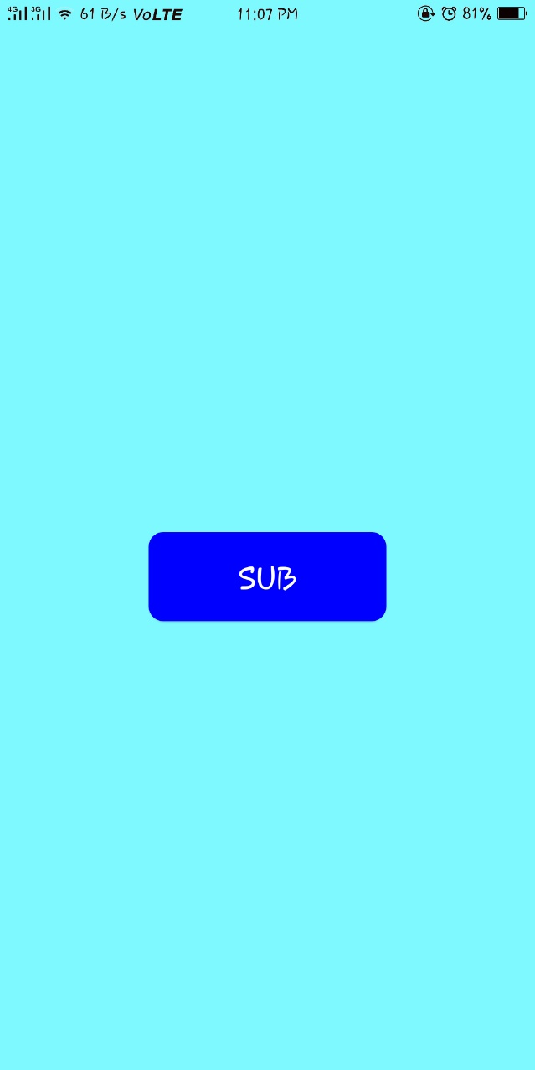
Change Sub BUTTON
<Button
android:id="@+id/subButton"
android:background="@drawable/button"
android:text="@string/sub"
android:textColor="@color/white"
android:textSize="24sp" />

Slide 27
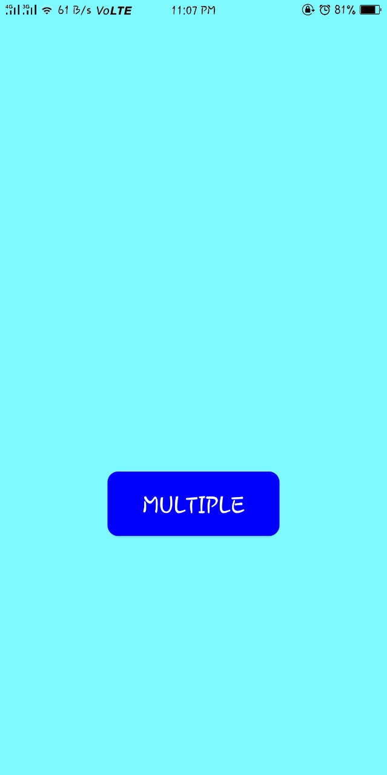
Change Mutiply BUTTON
<Button
android:id="@+id/mulButton"
android:background="@drawable/button"
android:text="@string/mul"
android:textColor="@color/white"
android:textSize="24sp" />

Slide 28
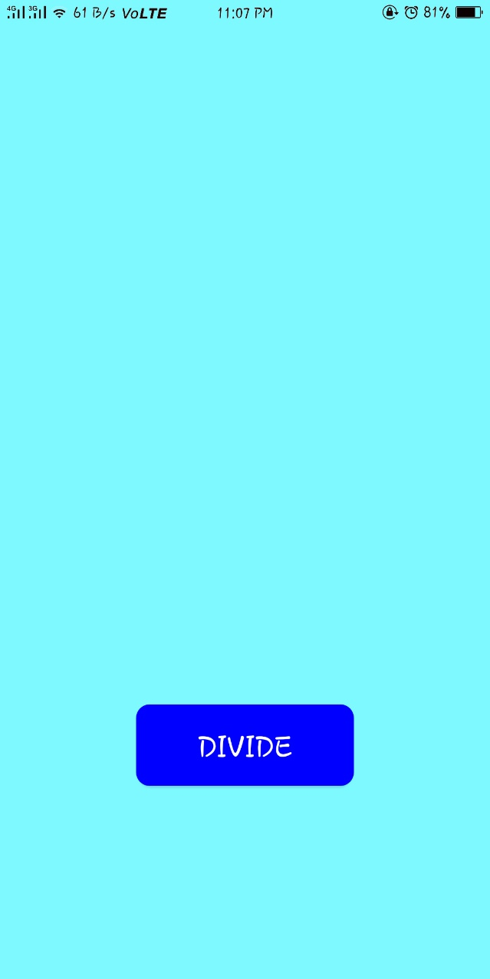
Change Divide BUTTON
<Button
android:id="@+id/divButton"
android:background="@drawable/button"
android:text="@string/div"
android:textColor="@color/white"
android:textSize="24sp" />

Slide 29
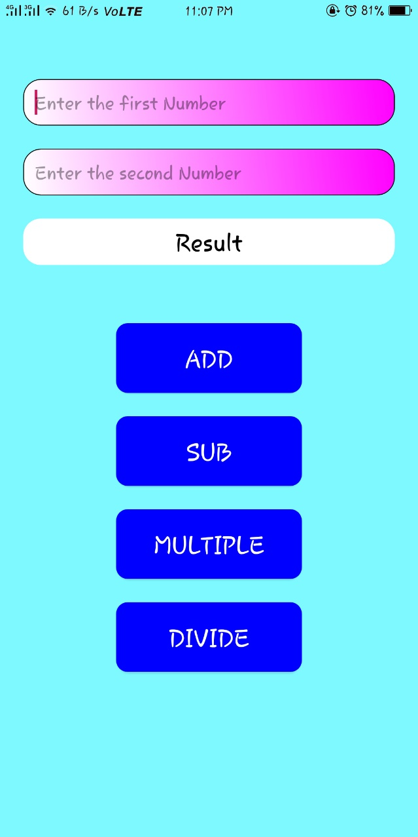
At Last
Find Warnings and Errors occurred

Slide 30
One more think - Manifest
<application
android:allowBackup="true"
android:fullBackupContent="true"
android:icon="@mipmap/ic_launcher"
android:label="@string/calc"
android:roundIcon="@mipmap/ic_launcher_round"
android:supportsRtl="true"
android:theme="@style/AppTheme">
<activity android:name=".MainActivity">
<intent-filter>
<action android:name="android.intent.action.MAIN"/>
<category android:name="android.intent.category.LAUNCHER" />
</intent-filter>
</activity>
</application>

Slide 31
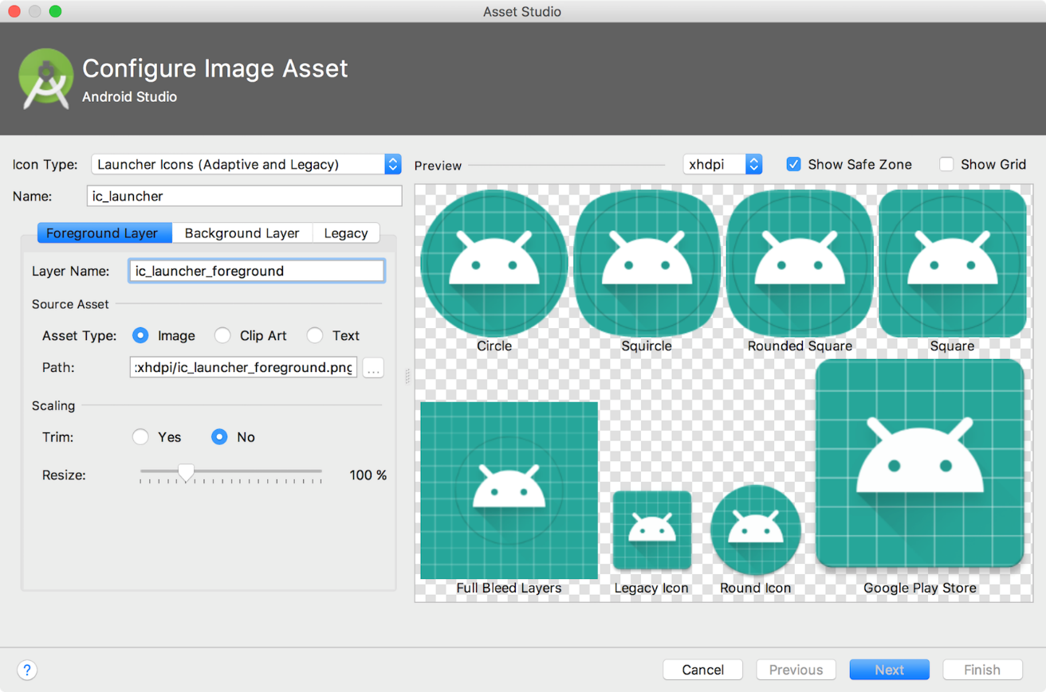
Set Icon

Slide 32
Set APP ICON
Choose icon or create icon in (.png) format
Right click drawable res set
Click New -> Image Asset
Choose icon file name
Choose icon type (Adaptive and Legacy)
Adjust Scaling and Click OK

Slide 33
Back End

Slide 34
Objective
Get the number from firstNumber and secondNumber
Process arithmetic operations according to the button we pressed.
Set the result in resultText area

Slide 35
Create Variables
EditText firstNumber, secondNumber;
TextView resultText;
Button addButton, subButton, mulButton, divButton;
int fNum, sNum;
float result;

Slide 36
Refer an id from front end
firstNumber=findViewById(R.id.firstNumber);
secondNumber=findViewById(R.id.secondNumber);
resultText=findViewById(R.id.resultText);
addButton=findViewById(R.id.addButton);
subButton=findViewById(R.id.subButton);
mulButton=findViewById(R.id.mulButton);
divButton=findViewById(R.id.divButton);

Slide 37
Read Number and convert into int
public void readNumber(){
fNum=Integer.parseInt(firstNumber.getText().toString());
sNum=Integer.parseInt(secondNumber.getText().toString());
}

Slide 38
Listener for buttons
addButton.setOnClickListener(new View.OnClickListener() {
@Override
public void onClick(View v) {
readNumber();
result= (float) fNum + sNum;
resultText.setText(getString(R.string.result_value , result));
}
});

Slide 39
Any Queries?

